Slide 1
Marketing Campaign
Assignment 2B

Slide 2
Summary of company’s sales performance
The clothing retailer aims to attract the customers to purchase through company’s website.
The company’s sale's performance was found to be increasing when some products are frequently bought together.
The company’s sales performance is calculated by DateTime_Of_Purchase and the Purchase_Amount.
For the year 2017, the average sales of the product or the purchase amount is generated to be 135.9167.

Slide 3

Contd…
The purchase year is 2017 and the amount is 6382243.72.
When the average is taken for the purchase amount , the average is 135.9167.
It helps to track whether a product is selling above or lower its average value (Chandana, 2021).
Therefore each product gets sold at the rate of 135 and not below it.

Slide 4
Products purchased together
The attributes to check the products that are likely to be purchased are DateTime_Of_Purchase and Product_Name_List.
That is for which date and time, the product has been most sold to the customers are shown.
The two product from the datasets that are likely to be purchased are modern cotton bralette and modern cotton thong.
Company can focus on promoting these two products can help retain customers and also attract more customer to purchase in website.

Slide 5
Identification of customer segmentation
Customers segmentation is a method to tag and group customers according to their shared characteristic or interest (Shaik, 2019).
Here, the customers are segmented or grouped by:
Customer ID
DateTime_Of_Purchase
Product_Name_List
Purchase_Amount

Slide 6

Contd..
The customer segmentation is identified by the RFM (Recency, Frequency and Monetary) method.
DateTime_Of_Purchase is renamed to Recency that is the maximum days the product has been sold.
How recently a customer has made a purchase at the clothing retailer website.

Slide 7
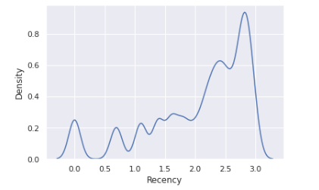
Contd…
Density vs Recency
The density illustrates the product sold and the recency shows the recent purchase of the customer.
Recency allows to check what product has been sold in large quantity in recent purchase.

Slide 8
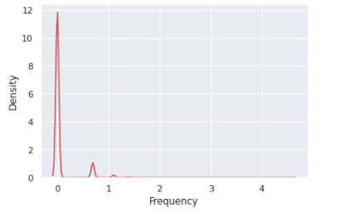
Contd…
Density vs Frequency
Product_Name_List is the count of product or quantity that is sold is Frequency.
How often the customer is making a purchase can be obtained with frequency. That is frequent buying of product.

Slide 9
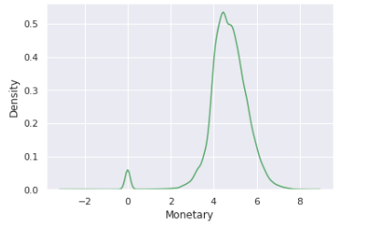
Contd…
Density vs Monetary
Purchase_Amount shows the sum of amount for the products purchased that is shown using Monetary.
Monetary is the money that the customer spends on the purchase.

Slide 10
Targeting potential customer
Application of K-means clustering is used in segmentation of customers.
Clustering analysis helped to categorize the customers based on their spending amount, recent purchase and frequent buying habits.
Using RFM method and K-means the potential customers of the clothing retailer company is targeted (Azevedo, 2023).
The women who buy the product modern bralette and modern thong are likely to purchase again and they should be targeted by marketing campaign.

Slide 11
Contd…
Marketing campaign uses demographic data of the customers to perform cluster analysis (Danurisa, 2022).
Marketing campaign can be conduced by identifying the product market, creation of buyer persona and brand messaging.
Setting marketing goals, final launch ad launching the cloth in market.
The price range can be lowered and launched in website landing page so the goals can be met.

Slide 12
References
Clustering Algorithm Based on E-Commerce Big Data. International Journal of Azevedo, N. (2023). Data Preprocessing: 6 Techniques to Clean Data. https://www.scalablepath.com/data-science/data-preprocessing-phase.
Chandana, D. (2021). Exploring Customers Segmentation With RFM Analysis and K-Means Clustering. https://medium.com/web-mining-is688-spring-2021/exploring-customers-segmentation-with-rfm-analysis-and-k-means-clustering-118f9ffcd9f0.
Danurisa, A. R. (2022). Customer Clustering Using the K-Means Clustering Algorithm. Budapest International Research and Critics Institute-Journal.
Shaik, I. (2019). K-means f Innovative Technology and Exploring Engineering (IJITEE).

